Slide 1

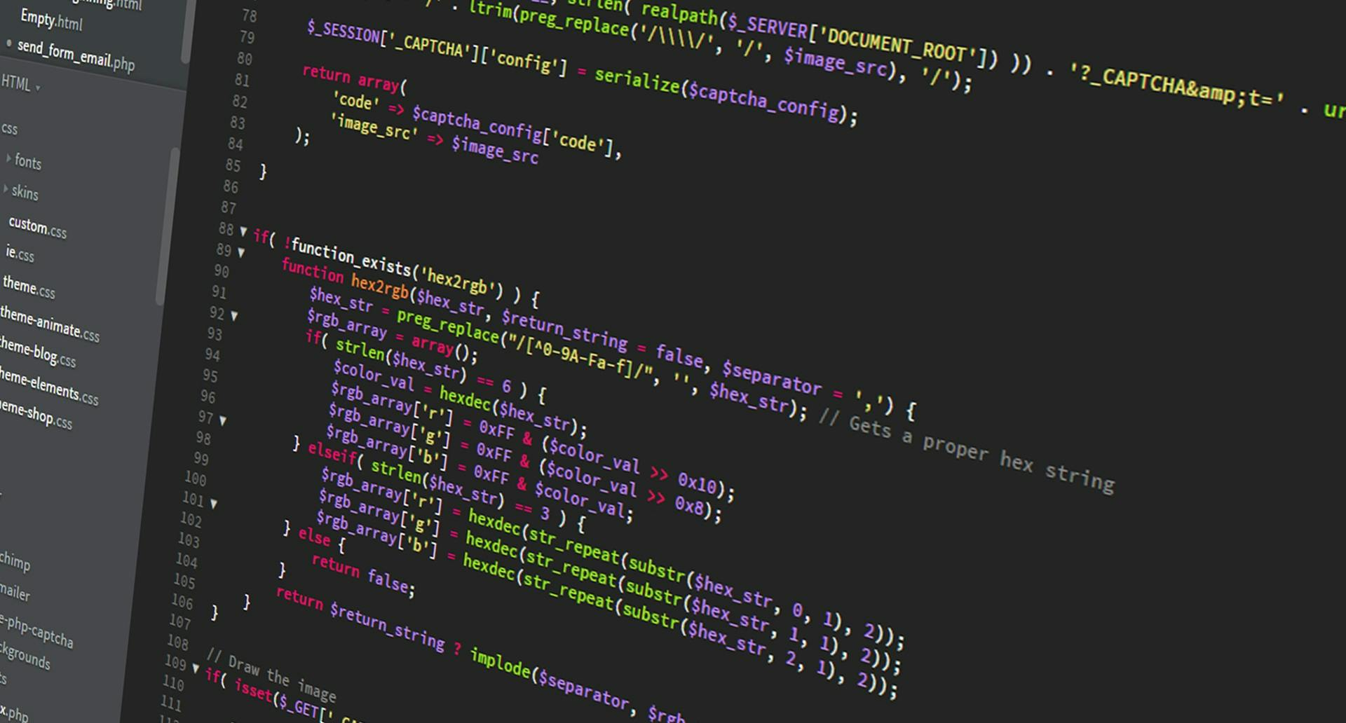
Programming 2B-PROG6212
Keenan Ghisyan ST10159832
PowerPoint Explanation Of Final POE Monthly Claim System

Slide 2
Comprehensive overview of the monthly claim system
The Model-View-Controller (MVC) architecture was used to create the multi-role application known as the Monthly Claim System. To provide modularity and effective data and workflow management, this architecture divides the application logic into three interconnected components: Model, View, and Controller. Each of the three primary positions supported by the system, Lecturer, Coordinator, and Academic Manager which each have unique features and user interfaces (Rick-Anderson, n.d.).
The data and business logic of the application are represented by the model. Entity classes like LecturerViewModel and ClaimViewModel, which store important data including lecturer information and claim submissions, are included. The Model offers a solid foundation for managing the system's data by handling data validation and guaranteeing consistency (Rick-Anderson, n.d.).
As the user interface layer, the View shows users data according to their roles. It has a variety of pages designed to meet the demands of different users. For example, the Home Screen has navigation buttons for role selection. Lecturers enter claim information, including the date, number of hours worked, hourly rate, and total amount, on the Claim Submission Page. While Academic Managers use the Claims Page to examine all claims and take appropriate action, including approving or rejecting them, Coordinators use the Review Page to see and handle submitted claims (Rick-Anderson, n.d.).

Slide 3
Comprehensive overview of the monthly claim system
The Controller serves as an interface for the View and the Model. It handles workflow management, changes the View, and processes user input. Controllers are in charge of essential responsibilities like updating claim statuses, validating and storing claim facts, and rerouting users according to their roles. This preserves data integrity while guaranteeing seamless user-system interaction(Sheldon, 2023).
Logging into the system and entering claim details, such as the date of work, hours worked, hourly rate, and total amount, which can be manually input or automatically calculated, are part of the Lecturer position. To provide transparency and accessibility to their data, lecturers can also check the history of claims they have lodged(Sheldon, 2023)
Program coordinators can access, and review claims made by lecturers within their program by logging in with the Coordinator status. To ensure a transparent and organized review process, coordinators have the authority to determine whether a claim has to be escalated to an academic manager or requires additional action(Sheldon, 2023).
All claims can be accessed with the administrative rights given by the Academic Manager position. After reviewing the claims submitted by Program Coordinators, Academic Managers decide whether to accept or reject them. To guarantee accurate documentation and tracking within the system, they also update the claims' statuses(Sheldon, 2023).

Slide 4
Highlight of its FEATURES
A seamless user experience is offered by the role-based navigation system in the Monthly Claim System. Buttons for the various user roles such as Lecturer, Coordinator, and Academic Manager, are included on the home screen, making it simple for users to access their particular functionality. Every position has its own login page that gathers the necessary user information, including ID, name, email, and phone number.
The system facilitates the process of submitting and reviewing claims. By entering information such as hours worked, hourly rates, and total amounts, lecturers can submit claims. The claims can be examined by program coordinators and academic managers, who can make sure that applications are handled effectively and fairly.
Dashboards are customized for every function via the dynamic user interface (UI), which improves usability. To ensure clarity and productivity, role-specific dashboards concentrate on presenting claims that are relevant to the user. Users can evaluate, change, or manage claim statuses due to the tabular formats in which claims are shown.
The system uses databases to handle data by storing user and claim information, allowing for temporary data persistence while the system is operating. Entity models like LecturerViewModel and ClaimViewModel are used to manage structured data, guaranteeing systematic and effective information processing.
Finally, the system includes strong validation and error handling. When navigation mistakes or invalid inputs happen, users are guided by clear error messages. Furthermore, validation logic is in place to guarantee that only accurate and complete data can be supplied, reducing the possibility of mistakes and improving system reliability overall.

Slide 5
FUNCTIONALITY
Lecturer Workflow:
Submit personal details and navigate to claim submission.
Enter claim details, including hours worked and the amount calculated based on the hourly rate.
View previously submitted claims.
Coordinator Workflow:
View claims submitted by lecturers assigned to their program.
Review individual claims and navigate to a detailed view for further actions.
Academic Manager Workflow:
View all claims under their purview.
Approve or reject claims, updating the claim status.
Manage processed claims.

Slide 6
BENEFITS
By automating important steps such as tracking, status updates, and claim submission, the Monthly Claim System streamlines workflows. All user roles, lecturer, coordinator, and academic manager, save a lot of time because to this automation, which also lessens the need for manual or paper-based processes, increasing operational efficiency and lowering the risk of errors.
Through the use of temporary in-memory storage, the system guarantees better data management and allows for seamless operation during user sessions. In addition to efficiently organize data, structured data models like LecturerViewModel and ClaimViewModel also enable smooth interaction with future database systems, should the need arise.
Role-based views restrict users to viewing just claims that are related to their duties by emphasizing transparency in claim handling. Because users may monitor the progress and actions performed on submitted claims, the visibility of claim status updates promotes accountability.
The system is scalable and adaptable, with modularity that facilitates the simple addition of additional features such as email notifications and comprehensive reporting. It is based on the MVC architecture. This adaptability also makes it possible to integrate with cloud services, which would improve data storage capacity and scalability to meet growing system demands.
Lastly, the system offers a better user experience by creating user-friendly interfaces that are customized to meet the unique requirements of various positions. Tables and forms in well-organized layouts that makes navigation easier and guarantees that users can complete activities quickly and without unnecessary complication.

Slide 7
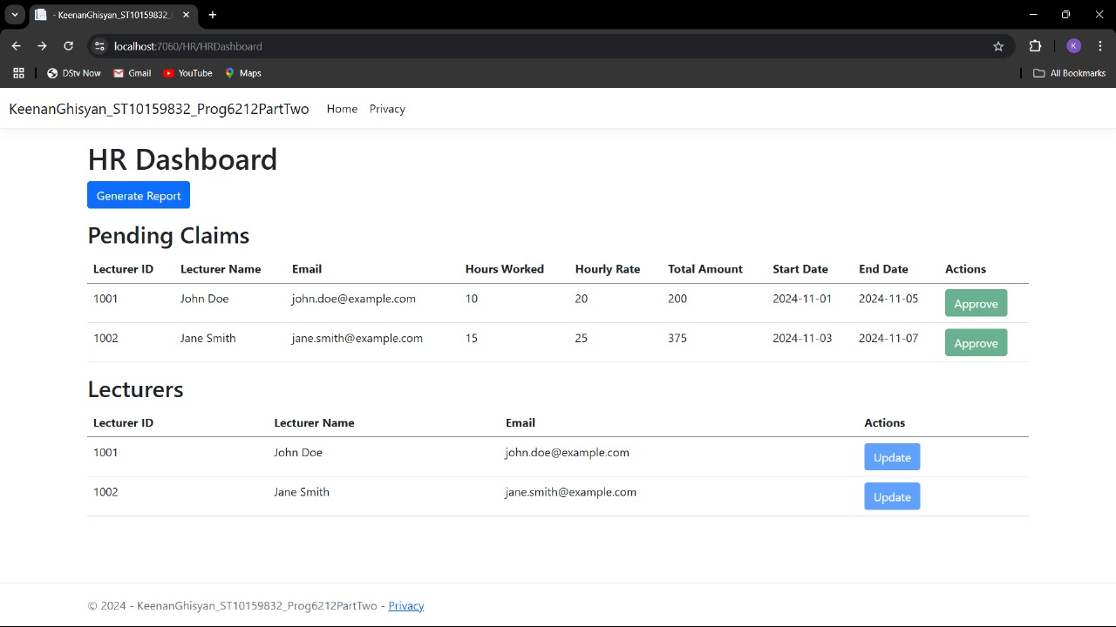
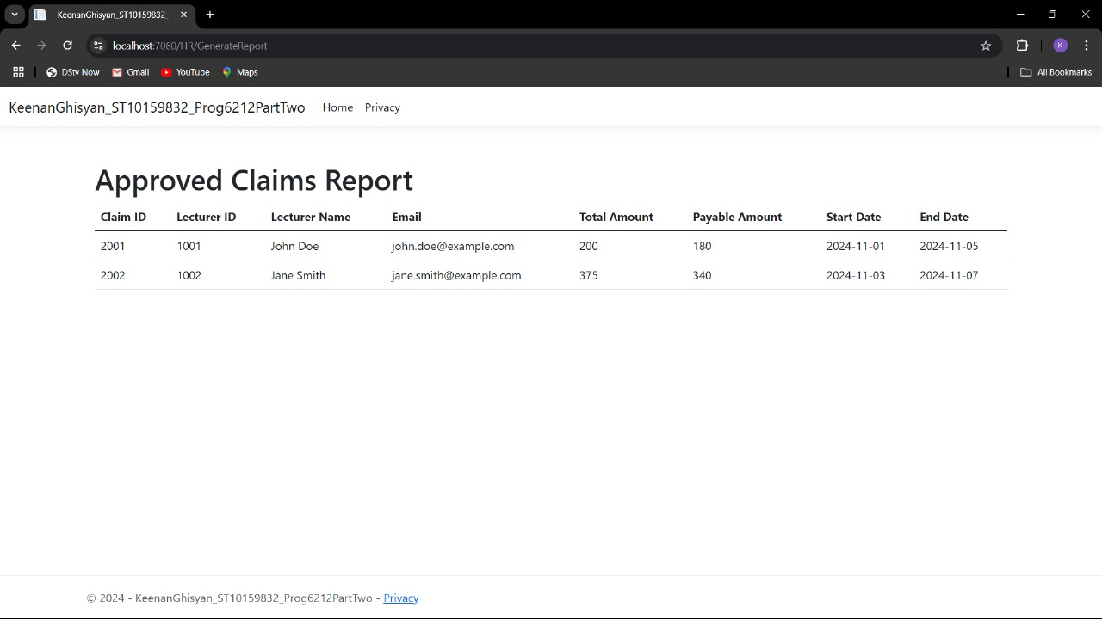
Screenshots of the monthly claim system

Slide 8
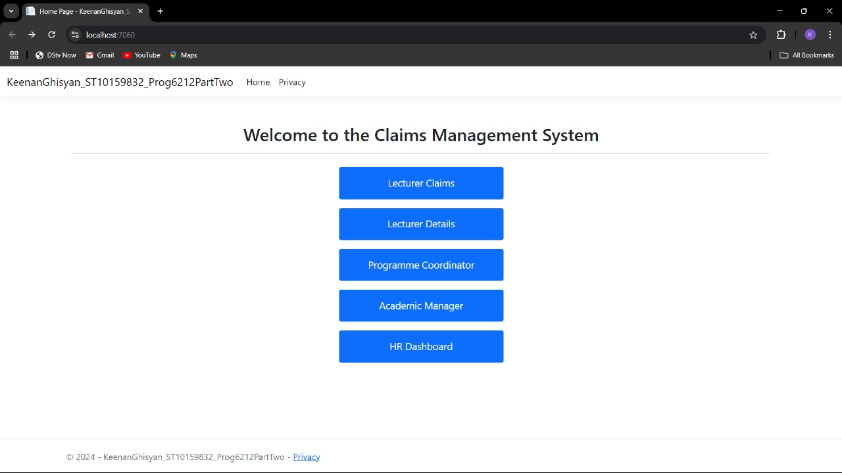

Screenshots of the monthly claim system

Slide 9
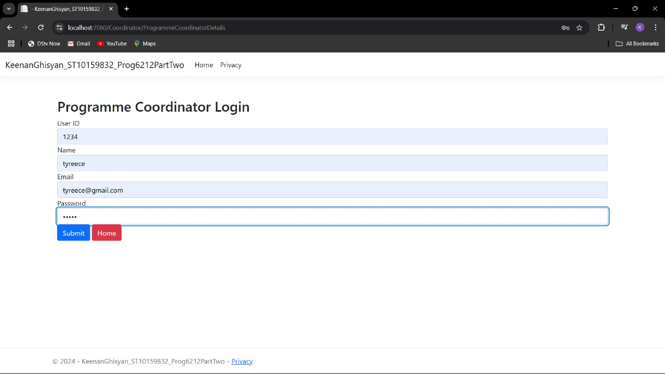
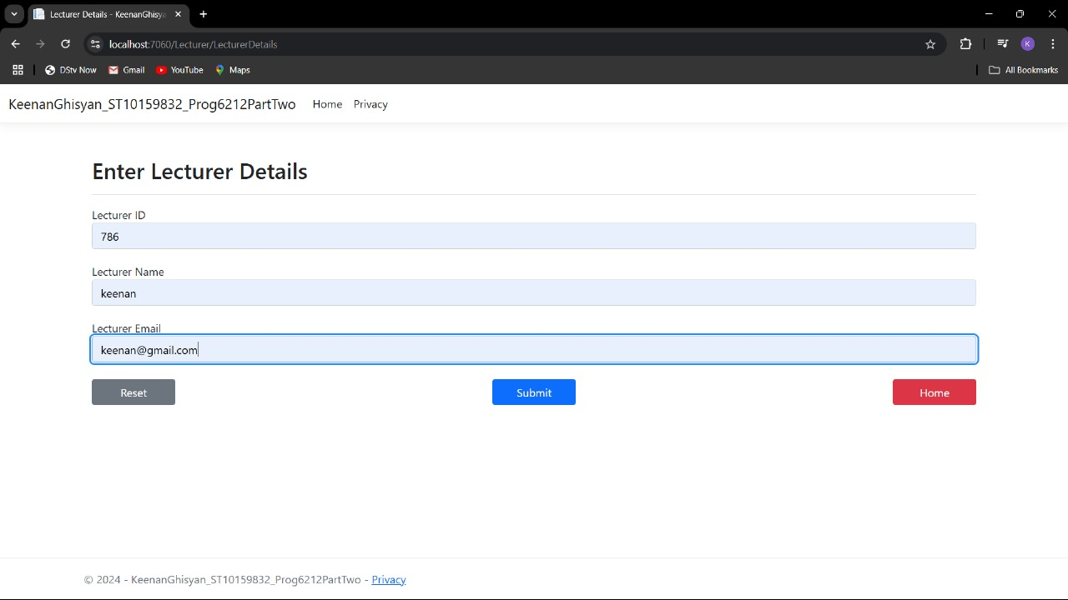
Screenshot of monthly claim system

Slide 10
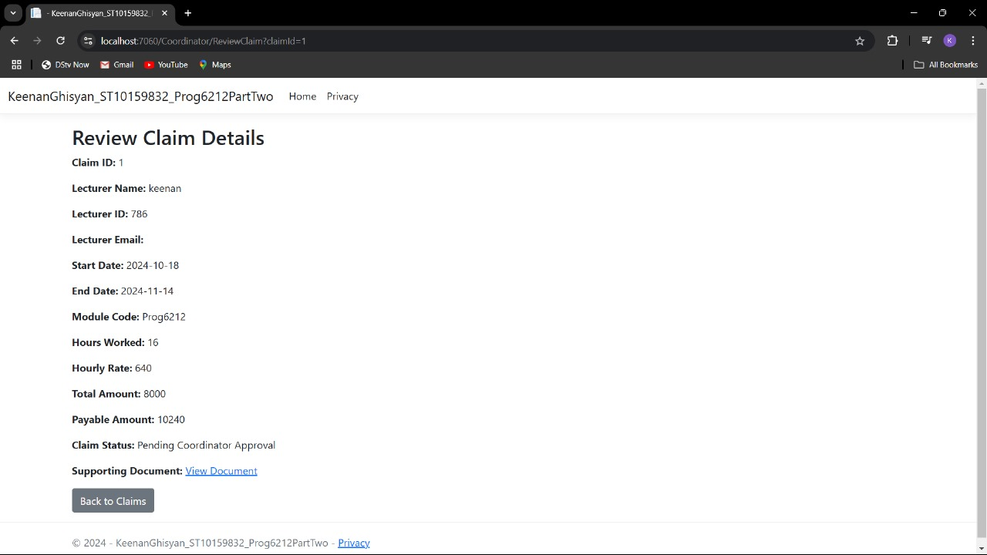
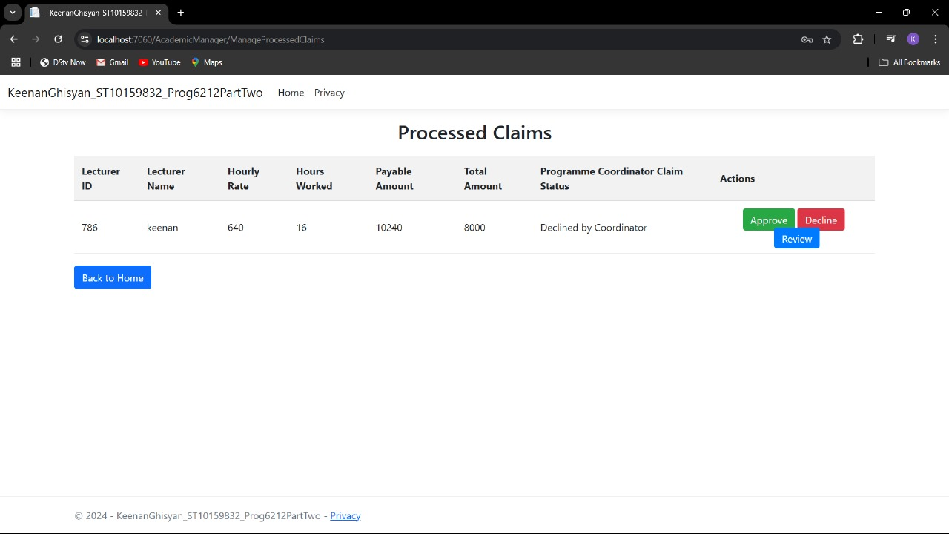
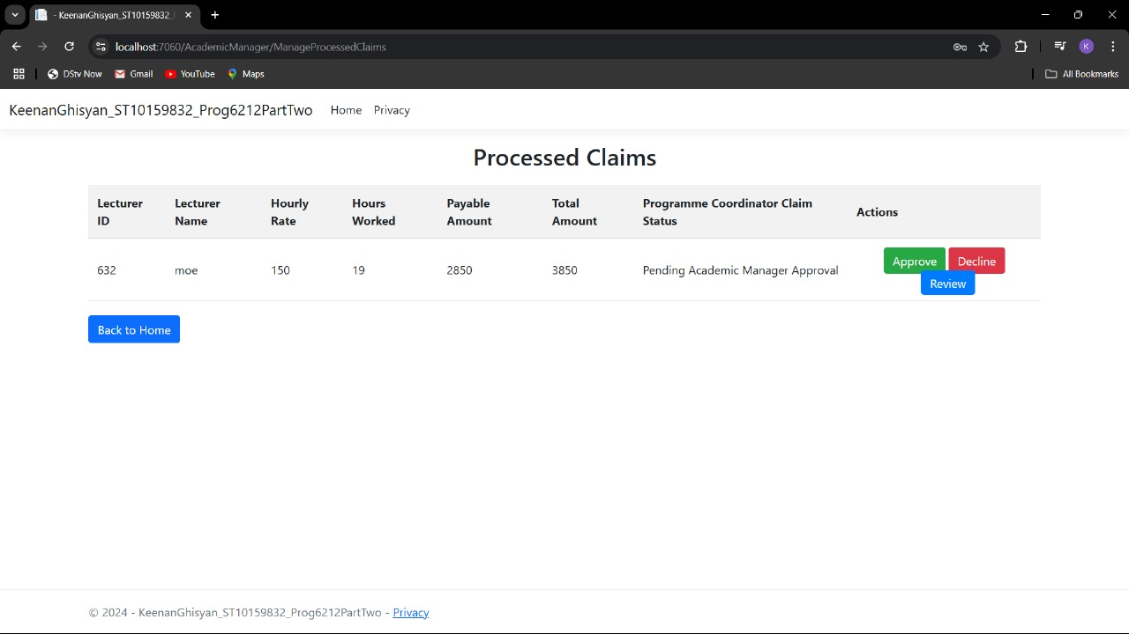
Screenshot of monthly claim system

Slide 11
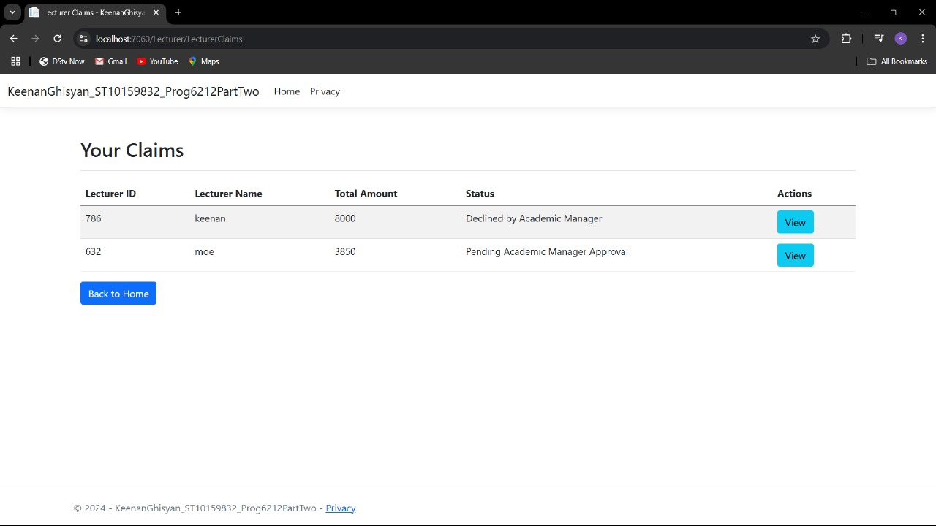
Screenshot of monthly claim system

Slide 12
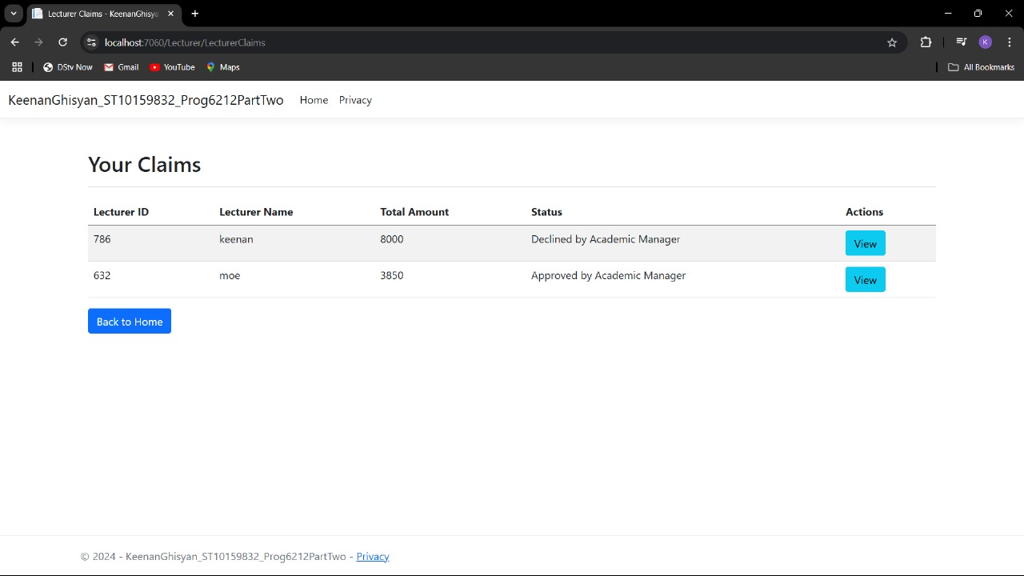

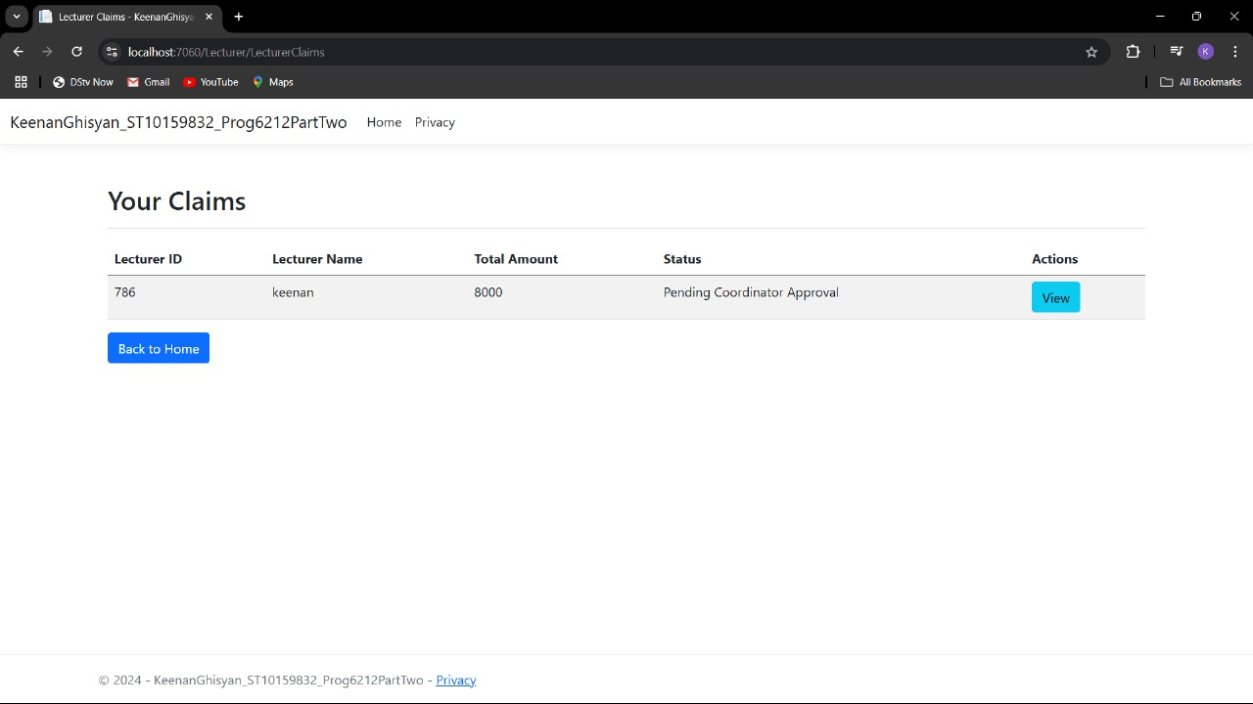
SCREENSHOT OF MONTHLY CLAIM SYSTEM

Slide 13
SCREENSHOT OF MONTHLY CLAIM SYSTEM

Slide 14
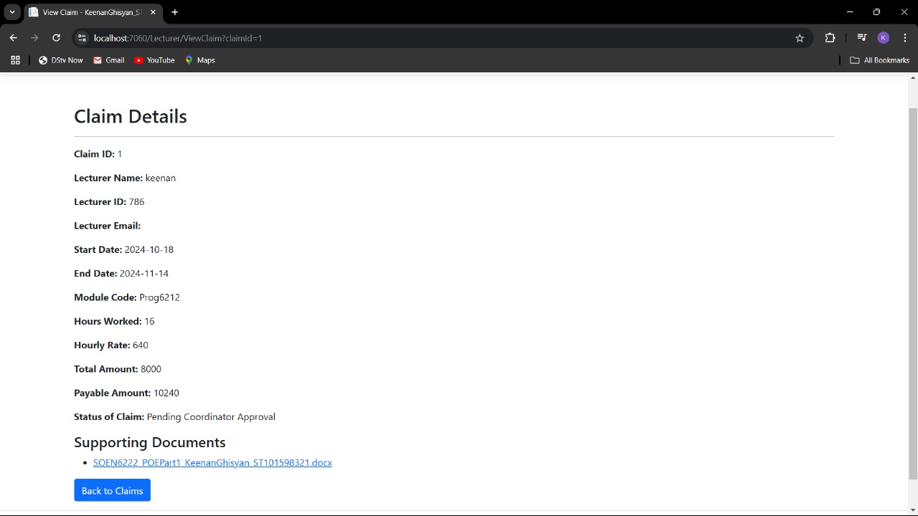
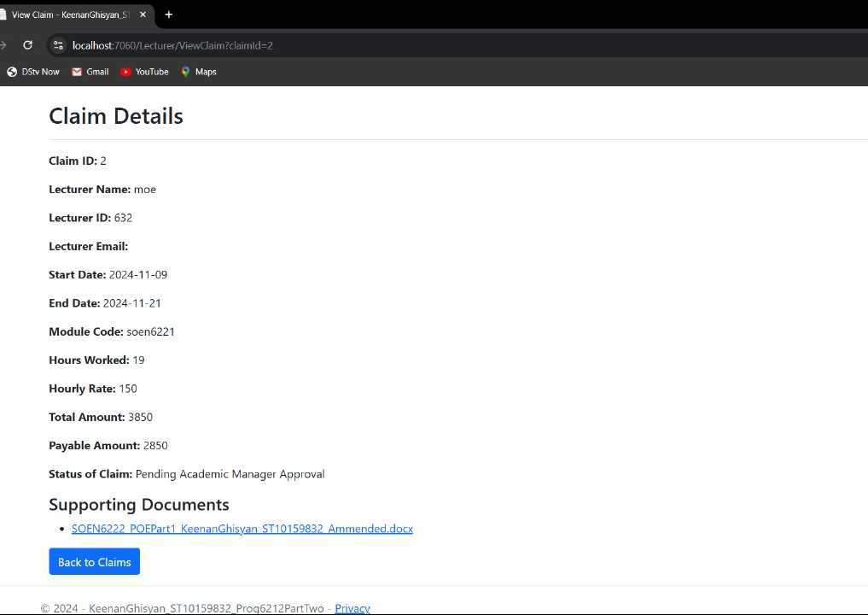
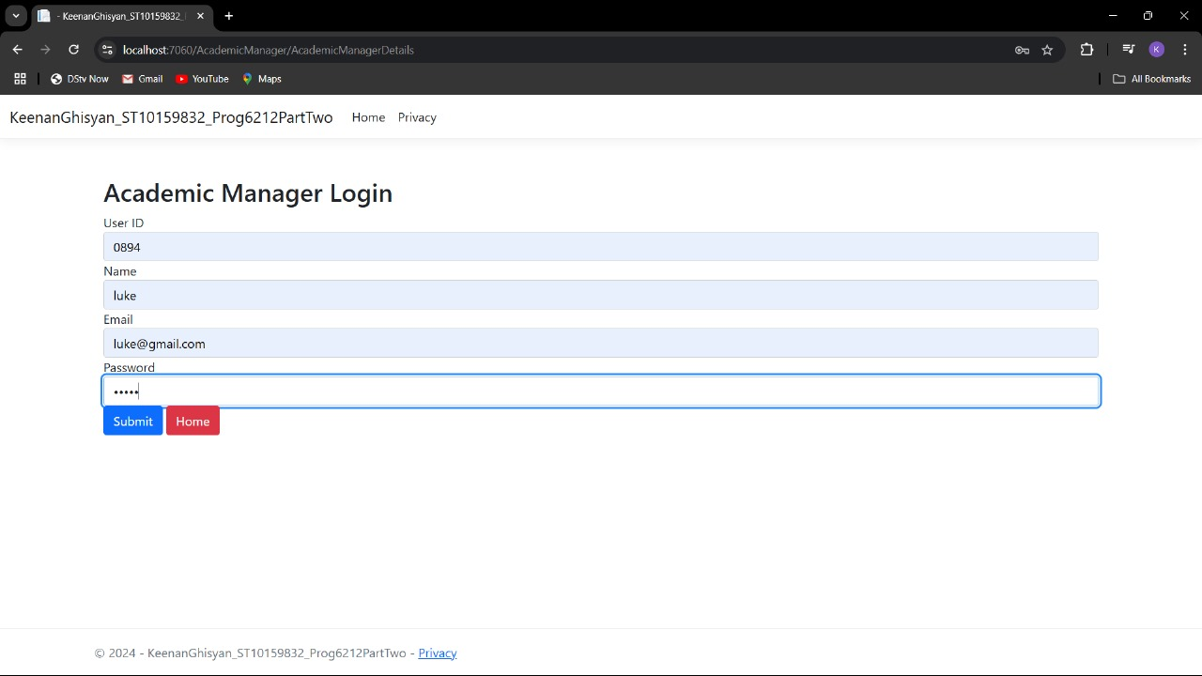
SCREENSHOT OF MONTHLY CLAIM SYSTEM

Slide 15
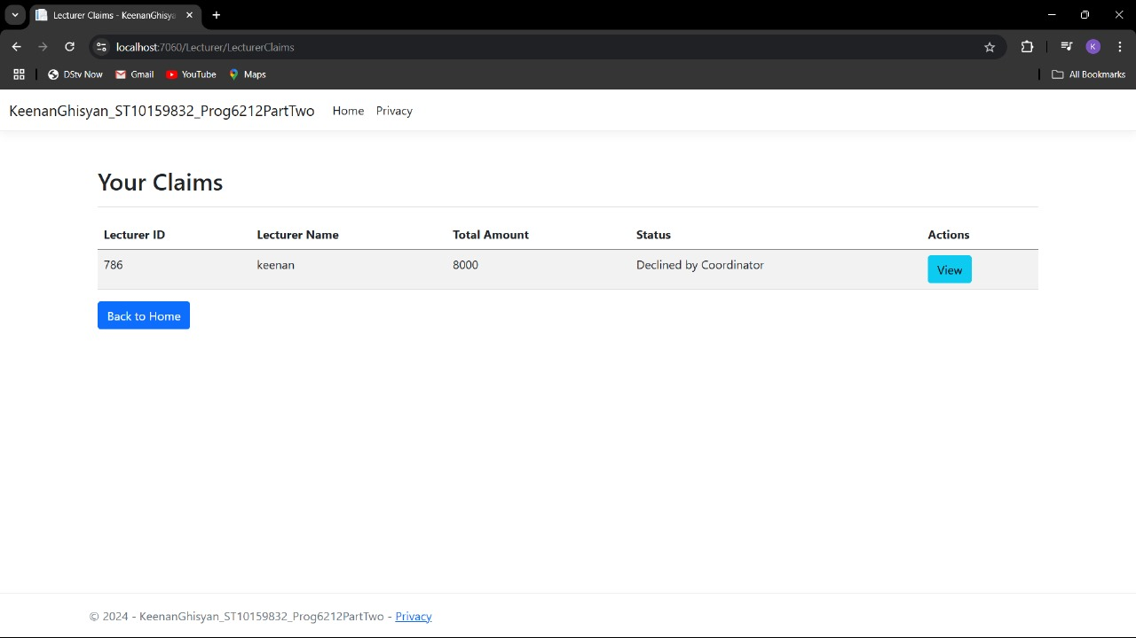
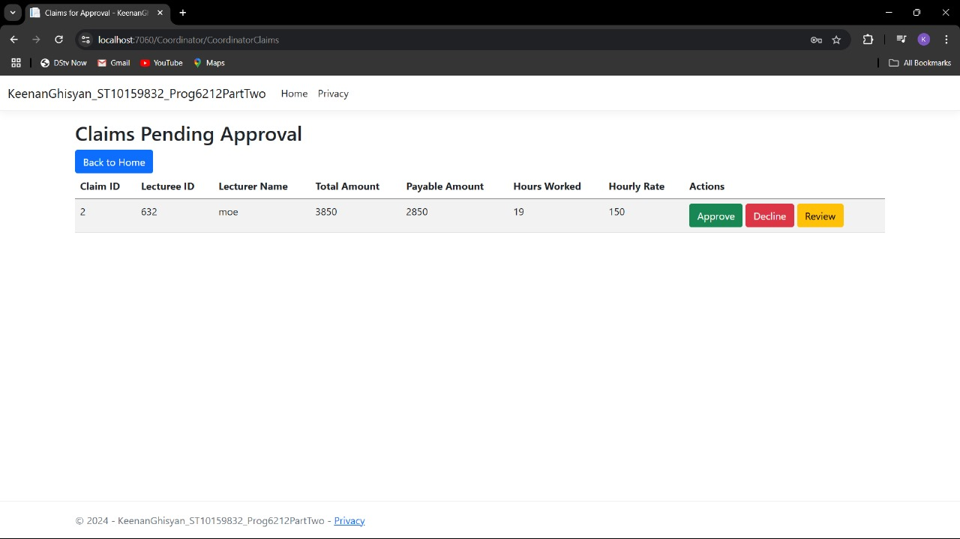
SCREENSHOT OF MONTHLY CLAIM SYSTEM

